Slide 1
Satelitný prijímač
2018/19
Ľ.Maceková

Slide 2
Satelitný príjem na povchu Zeme
The Outdoor Unit (ODU) is located where it will have a clear line of sight to the satellite and is free from casual blockage by people and/or equipment moving in front of it. It includes the Radio Frequency Trasceiver (RFT).
The Inter Facility Link (IFL) carries the electronic signal between the ODU and the Indoor Unit (IDU) as well as power cables for the ODU and control signals from the IDU.
The Indoor Unit IDU is normally housed in a desktop computer at the User’s workstation and consists of the baseband processor units and interface equipment (e.g. computer screen and keyboard). The IDU will also house the modem and multiplexer/demultilexer (mux/demux) units if these are not already housed in the ODU.

Slide 3
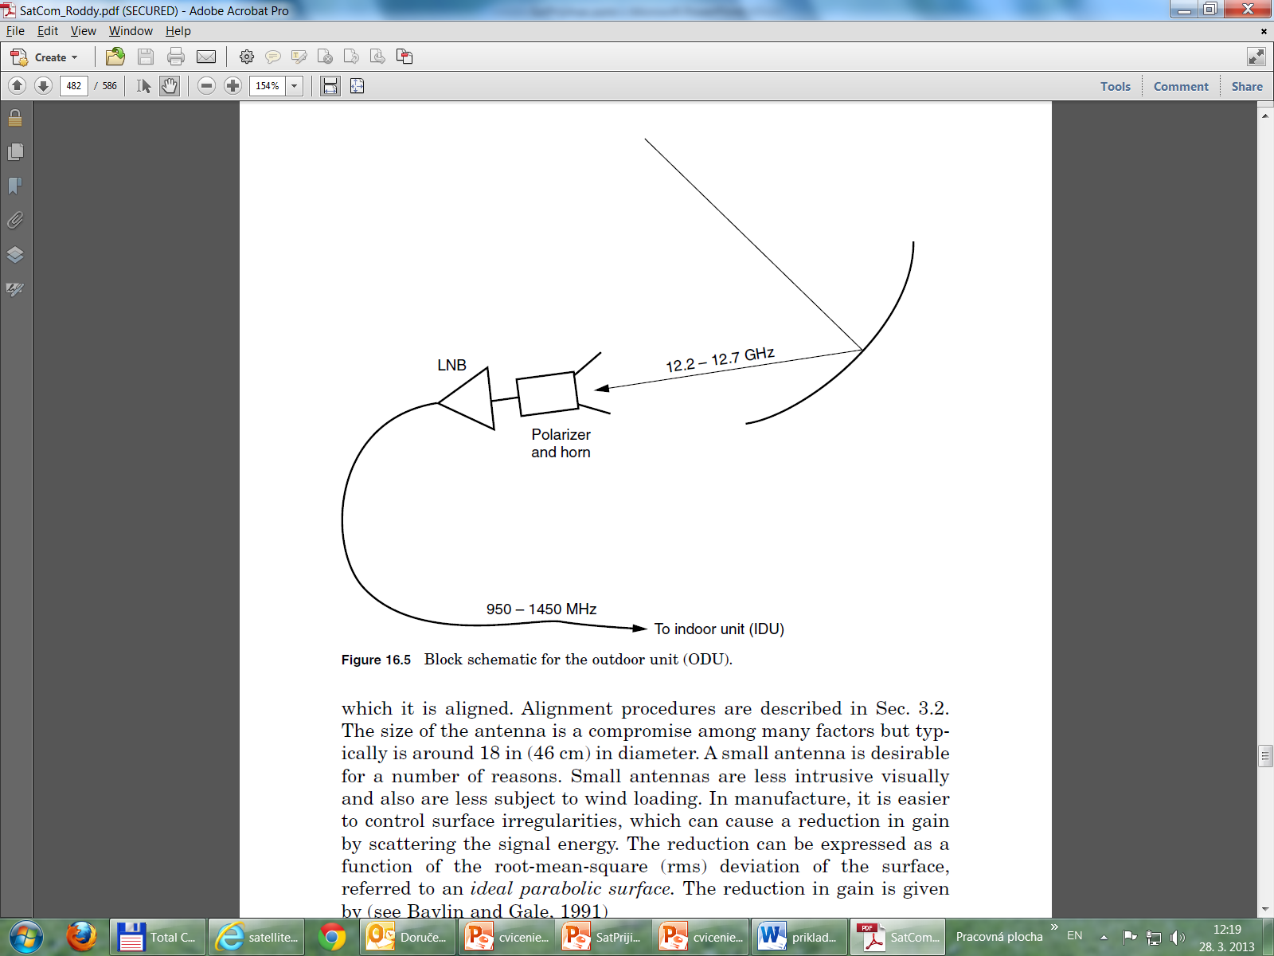

Slide 4
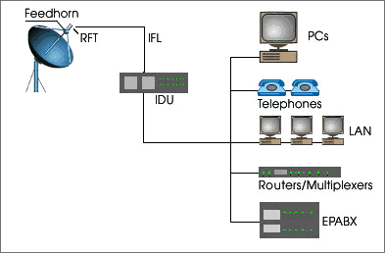
Pozemská stanica

Slide 5
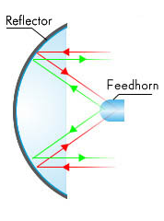



Pozemská stanica – bloková schéma
Antenna
Feed
LNC
IFL
DEM
Base Band Processor
(BBP)
To
Data Terminal Equipment
HPC
MOD
RFT
Outdoor Unit (ODU)
Indoor Unit (IDU)
IDU
RFT
IFL

Slide 6
ako vzniká TV – sat. signál (DVB-S)?

Slide 7
Vrstvy systému MPEG-2 (vznik transportného reťazca)
Nekomprimovaný reťazec
MPEG-reťazec
ES-elementary stream
kódovanie MPEG-2
Zdrojové video
Paketovanie
PES (Packetized Elementary Stream)
TS-Transportný reťazec MPEG-2
Zdrojový zvuk
Multiplexer
kódovanie MPEG-2
Paketovanie
Zdroj dát
Paketovanie

Slide 9
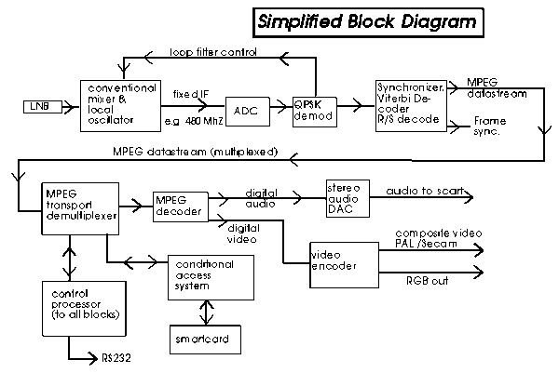
Potom v prijímači - opačné procesy
zdroj: http://www.drakesvision.com/digi4.htm

Slide 10
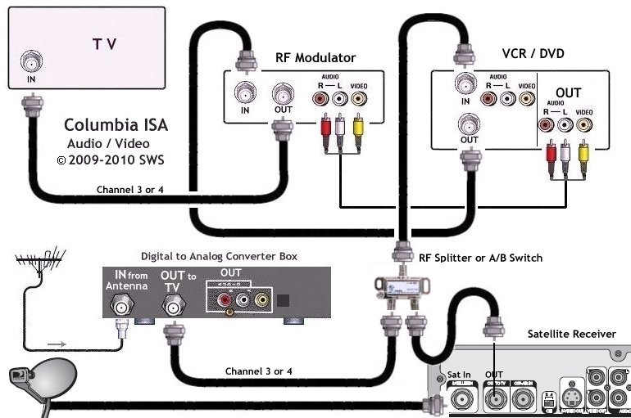
Domáci príjem sat. aj. terestr. TV

