Slide 1
STS – 2013/14 Exercise
N. 3
Satellite antenna
- construction and setting
Ľ. Maceková

Slide 2
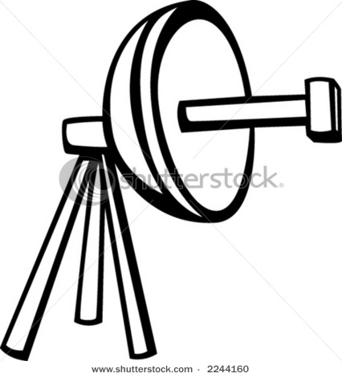
Now, we need some knowledge about antenna ☺

Slide 3
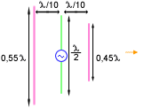
Some first information about antennas
Antenna is active component; it converts e-m radiation in free space into el. signal in conductor or/and vice versa
Directional antennas (radiated power is concentred and focused into particular direction → directional radiation pattern, shaped by design of antenna)
Isotropic antenna, isotropic radiator (omnidirectional ... – hypothetical – frequently used as referrence one for expressing of gain of real antennas in [dBi])
dipole (halfwave dipole): l=λ/2
direction of max. receiving
Another directional antennas (beam antennas)
reflector– passive element of antenna – reflects e-m radiation back to radiator, forms the radiation pattern, boosts the gain
radiator – active element of antenna – e.g. halfwave dipole (it can be also full wave antenna, and also loop antenna)
directors – passive elements of antenna – they form the radiation pattern (narrow main beam) and augment the gain
direction of comming e-m radiation /of signal
everything is fixed on the conductive or nonconductive pole

Slide 4
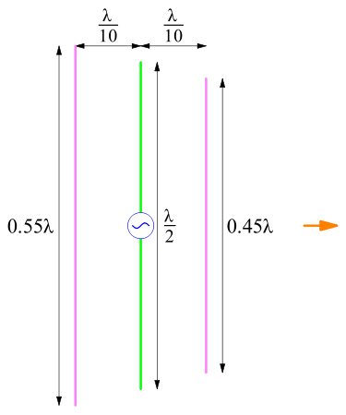
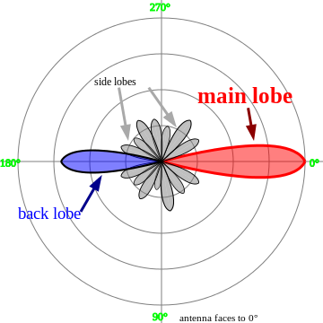
- Then, Yagi antenna and its radiation pattern:
radiator (dipole)
beamwidth of antenna (it is angle – in slovak language šírka zväzku, smerový uhol)
-3dB point (half power)
max. energy (power)

Slide 5
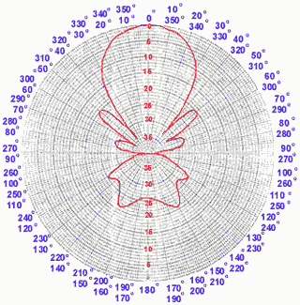
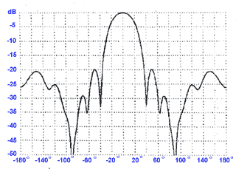
Fig. Illustration of antenna pattern in rectangular coordinates (this is „E“ plane; electrical intensity in dependence on angle) for typical 10-elements Yagi antenna
... and in polar coordinates

Slide 6
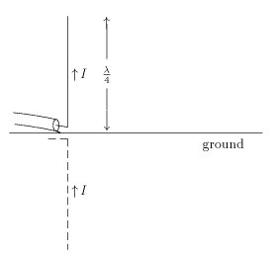
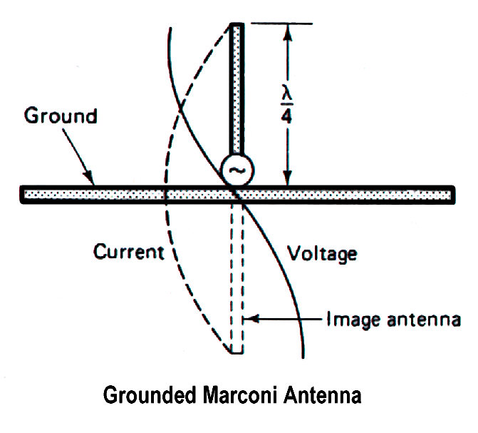
Btw., we have also quarter wave pole antenna (Marconi antenna):
coaxial cable
Fig. Relation between both current and voltage waves induced in 1/4-wave antenna.

Slide 7
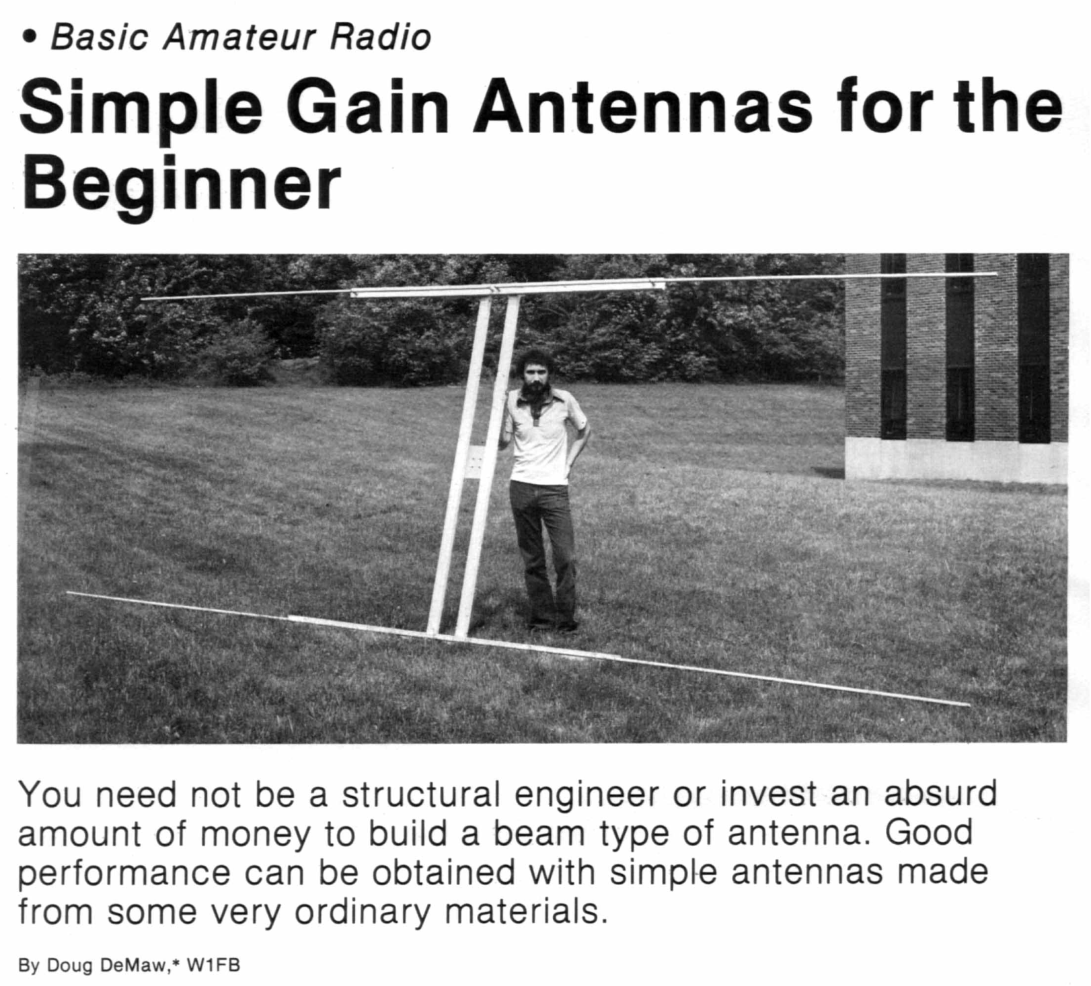
☺

Slide 8
Antenna designers try to enhance the angle effectivity (and gain) of antenna → various types and shapes of reflectors and radiators; for satellite receiving, there are parabolic reflectors (“dish”)

Slide 9
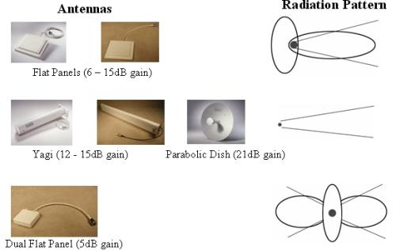

Slide 10
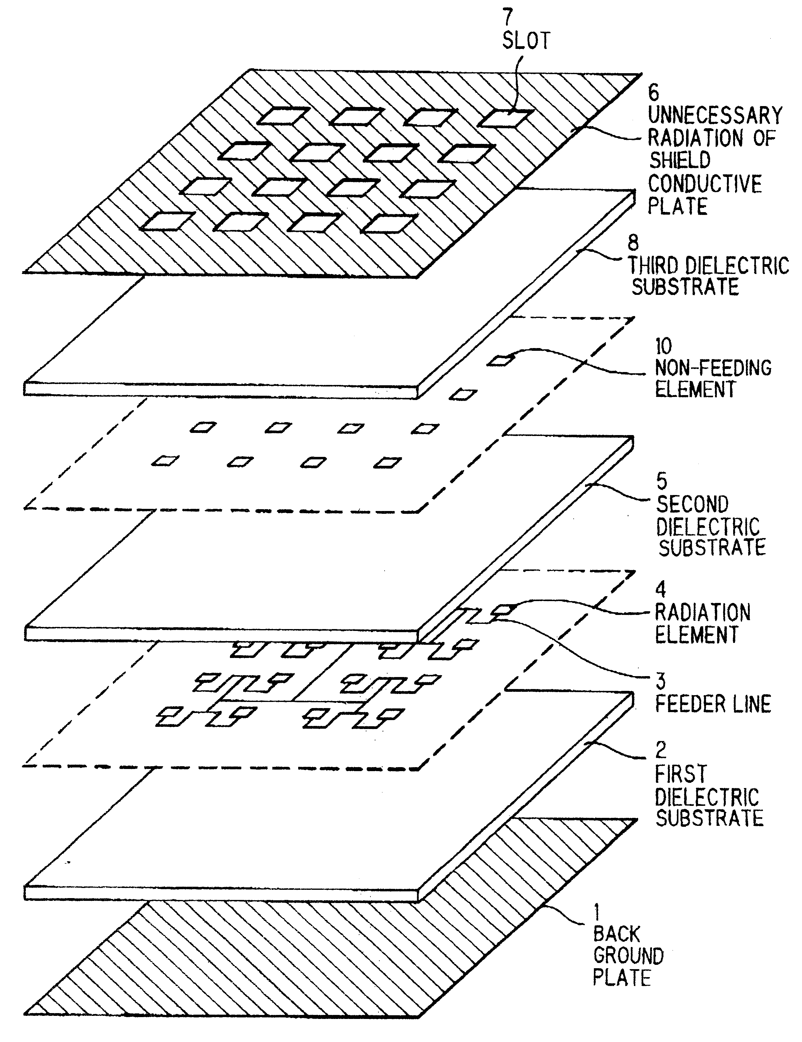
Flat antenna
active radiation flats (interconnected)
Obr. : Hitachi

Slide 11
Reflector antennas – parabolic, dish antennas
reflector
radiator (convertor)
Symmetrical, with radiator in the receiving direction
Ofset antenna (upper cut of parabolic surface – advantages: less proportions, doesn’t gather snow, dirt ...)
Ofset – Cassegrain (main reflector and hyperboloidal subreflector...)
Offset-Fed, Gregorian antenna

Slide 12
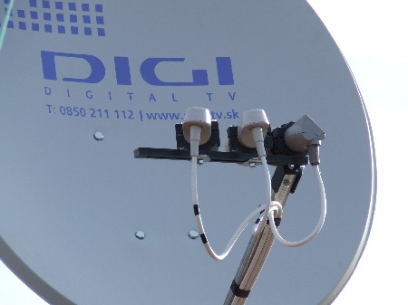
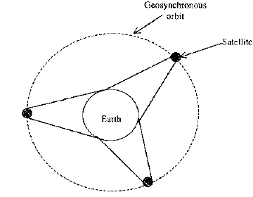
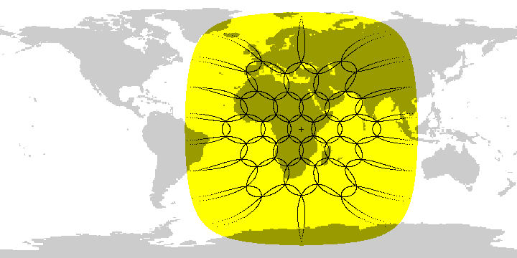
Fig. sat. antenna with several radiators and one dish
Fig. footprint – area covered by signal from sat. antenna with several radiators, from 1 GEO-satellite (3 GEO satellites together cover entire Earth –up to 75th parallel)

Slide 13
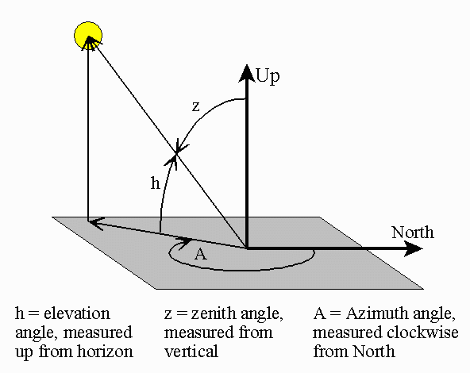
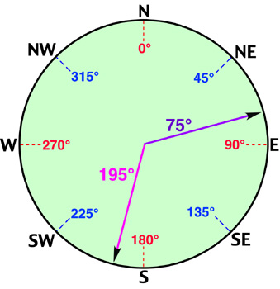
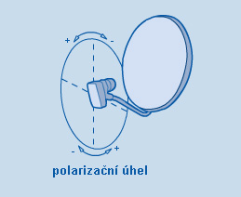
AZIMUT – oriented angle in the horizontal plane – between given direction and north direction (from the view of user)
Position of satellite and setting of receiving antenna - azimuth a elevation
- another view
the plane of horizon or the sea level
www.physicalgeography.net/.../angles_azimuth.jpg
www.srrb.noaa.gov/highlights/sunrise/azelzen.gif
Elevation (h) – angle in vertical plane measured from horizontal plane to the line of sight
LNB skew

Slide 14
Now, we can calculate both EL-elevation, AZ-azimuth - angles of satellite antenna setting:
If we are on south hemisphere:
Intermediate parameter h:
Value 0.1513:
Correction considering magn.declination:
where: S...position of satellite (longitude) in degrees; Easter longitude (°E ) must have negative value (minus)
L... longitude of receiver antenna posision; Easter longitude (°E ) must have negative value (minus)
B – latitude of receiving position
R – Earth radius
H – altitude of satellite above Earth
Calculation of LNB Skew (moving round of Low Noise Block):
Homework: Calculate azimuth and elevation of antenna for receiving chosen satellite in chosen place of Earth surface.

Slide 15
And now:
Antenna gain – in dependence on generalized aperture and referenced to gain of isotropic radiator :
Gain of parabolic antenna in dependence on both dish diameter an efficiency:
ηA ... effective radiated surface of antenna – depends on diraction of setting of antenna = A_{ef} [m²]
A ... aperture (physical surface, passed by e-m radiation) [m²]
η ... efficiency of aperture (0,35-0,75) [-]
λ ... wavelength [m]
... in comparison with isotropic antenna
G_{dBi} = 10 log G [dBi]
D ... diameter of dish (or of reflector, or of array of radiating elements, i.e. of aperture) [m]
Example: η=55%, f=11GHz, D=1m. G=?
Results: about 7299 and 38dBi
- actual gain is always < than value declared by producer (connection, direction and other unfavourable conditions)
Example: Calculate λ of frequency channel at 900 MHz.

Slide 16
References:
[1] J. Montana: Introduction to Satellite Communications, George Mason Univ. 2003 (presentation)
[2] Mobilné satelitné komunikácie (Preklad [4])
[3] M.O.Kolawole: Sat. Comm. Engineering.,Marcel Dekker, 2002, USA
[4] S.Omori, H. Wakana, S. Kawase: Mobile satellite Communications, 1998, Artech House, USA.

