Slide 1
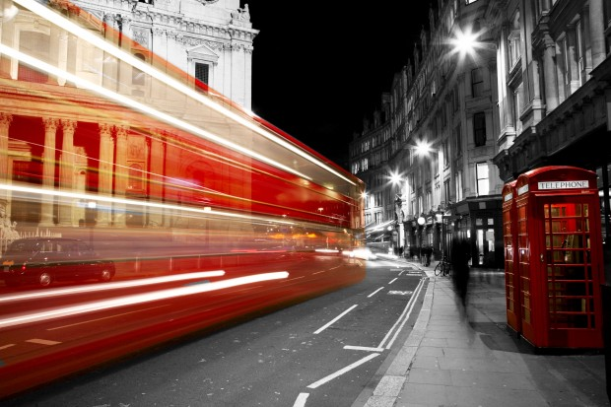
Welcome To
3–D World Of Technologies !
By - PRAGYA JAIN
CS-D
120283

Slide 2
CONTENTS
3-D PASSWORD
3-D PRINTING
3-D TATTOOS AND STREET ART
HOLOGRAPHY
3-D GLASSES
CONCLUSION AND FUTURE SCOPE

Slide 3
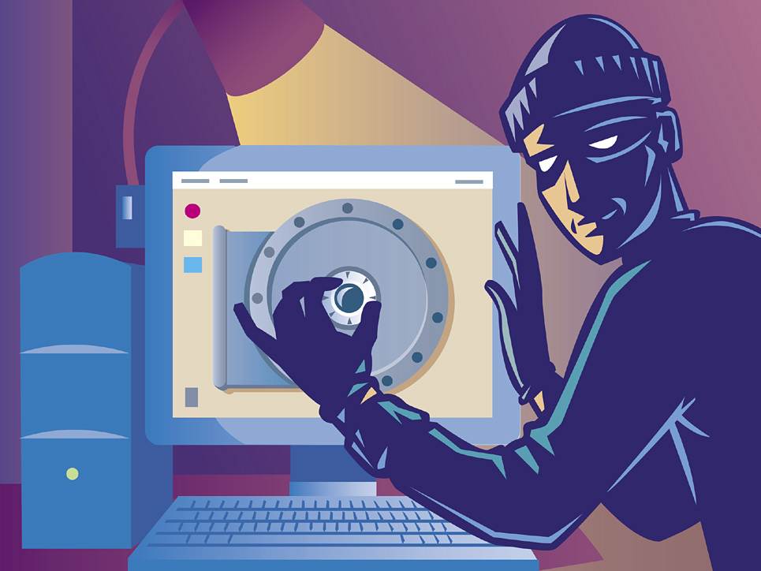
3 - D PASSWORD

Slide 4

              How secure is your password ?
Now with the changing technology , fast processors and many tools on the Internet, cracking password has become a Child's Play

Slide 5
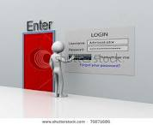
SETTING 3D PASSWORD !!
The 3D password presents a virtual environment containing various virtual objects
The user walks through the environment and interacts with the objects using navigators
The password is a combination and sequence of user interactions that occur in the 3D environment

Slide 6
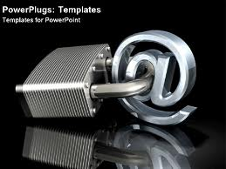
Advantages
Flexibility
Strength
Ease to Memorize
Respect of Privacy

Slide 7
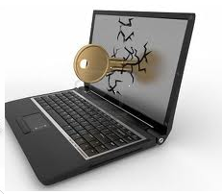
Applications
The 3D password’s main application domains are protecting critical systems and resources.
Critical Servers
Nuclear Reactors & military Facilities
Airplanes and missile Guiding

Slide 8
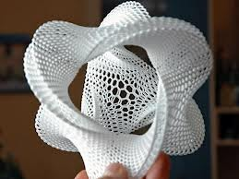
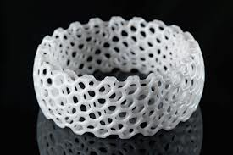
3 –D
PRINTING

Slide 9
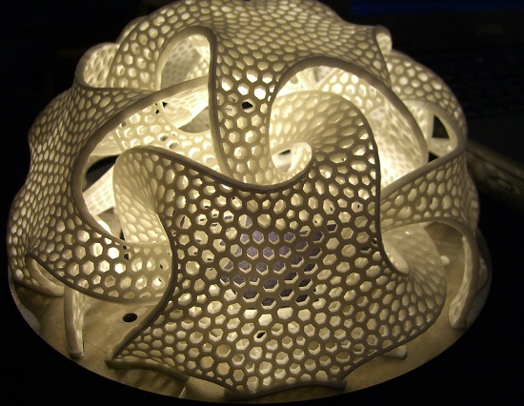
Θ All of us think of a printer as something that can print out documents, create informative newsletters etc. Although these are still the main functions of printing, there's also a new trend taking hold in the world of printing that does not involve only ink: 3D printing.
Θ This type of printing actually uses a larger printer, filled with a compound, to create 3D objects from blueprints created on-screen.

Slide 10
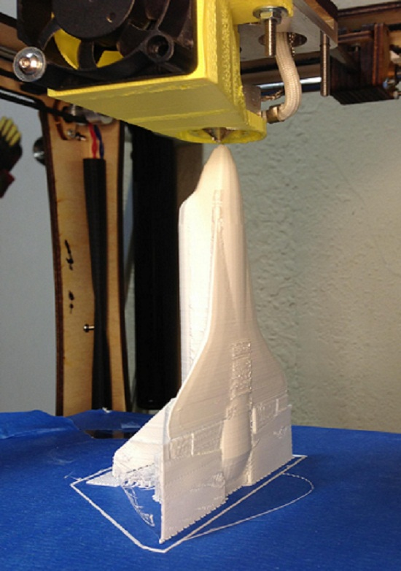
3 – D PRINTER & miniature model of a shuttle

Slide 11
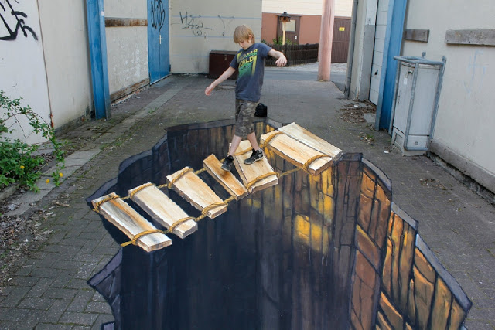
3 – D Tattoos And
3 – D Street Art

Slide 12
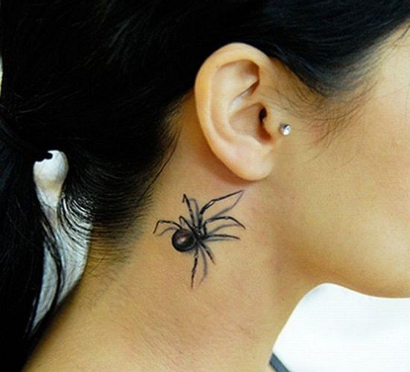

Slide 13
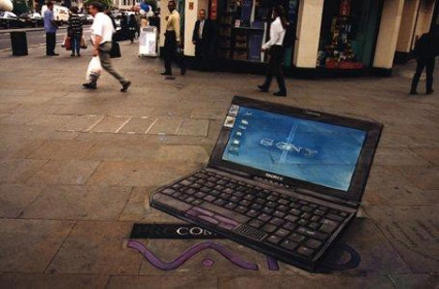

Slide 14
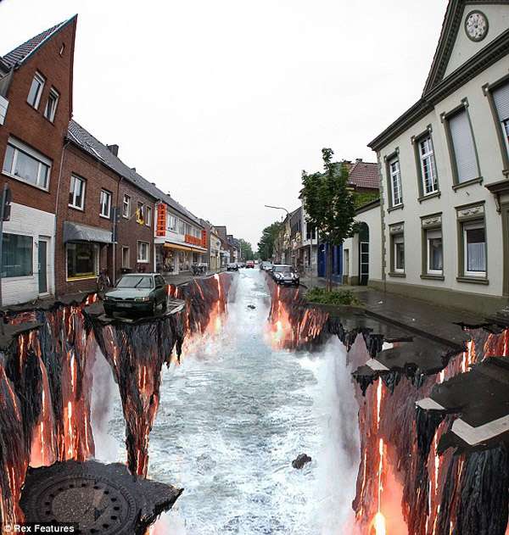

Slide 15

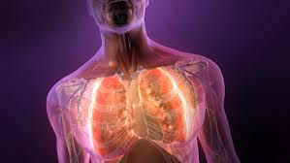
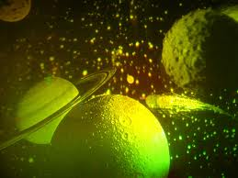
HOLOGRAPHY

Slide 16
Holography (from the Greek, whole + write) is the science of producing holograms invented by Dennis Gabor
It is an advanced form of photography that allows an image to be recorded in three dimensions
The technique of holography can also be used to optically store, retrieve, and process information

Slide 17
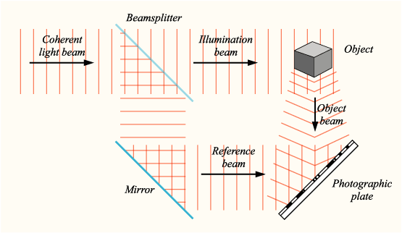
Hologram Working

Slide 18
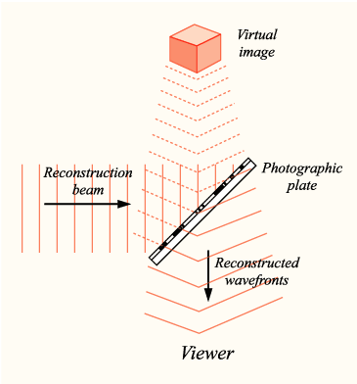
Hologram Reconstruction

Slide 19
Applications
AUTHENTICATION : Hologram stickers cannot be scanned or photocopied so they are used in authentication of passports ,books etc.
ATTRACTIVE : Hologram stickers can also used in packing as they create a unique and attractive complement to existing packaging

Slide 20
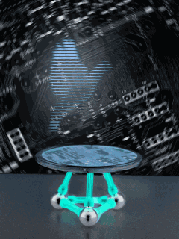
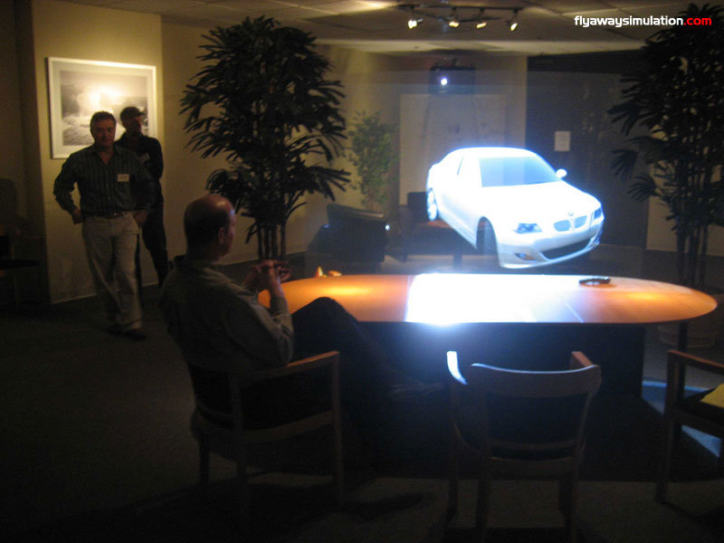
Virtual Display :
# Science –fiction movies
# For trade-show booths
# Museums display

Slide 21
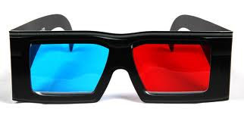
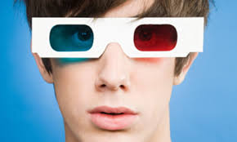
3-D GLASSES

Slide 22
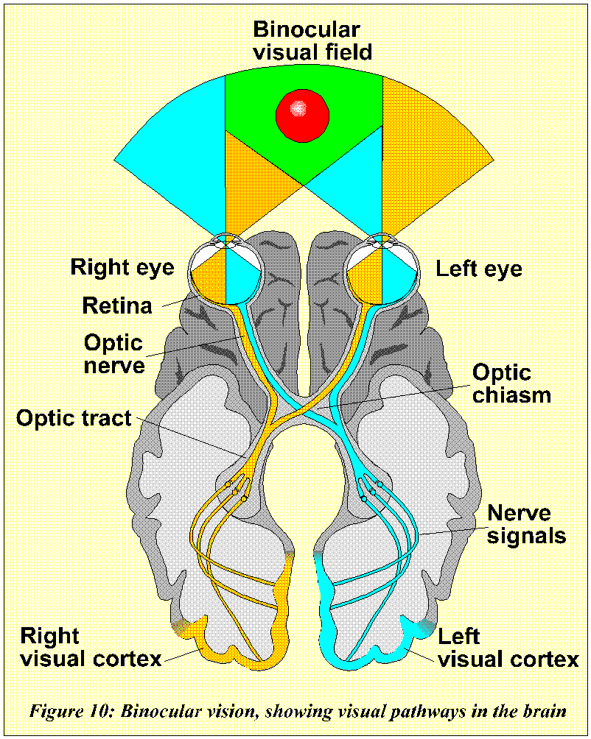
Working of Binocular Vision
Binocular vision is dependable on the distance between our eyes
Each eye sees the image at a slightly different angle

Slide 23
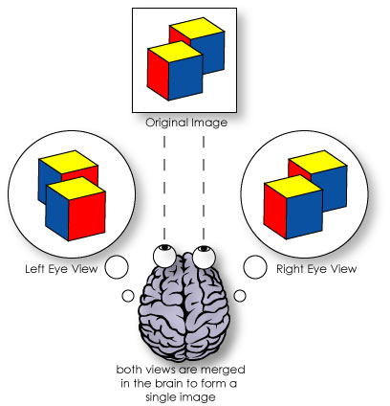
The brain takes the information from each eye and combines them into one image
Difference of angles makes image have depth

Slide 24
Types Of 3D Glasses :
Anaglyph
Pulfrich
Polarized

Slide 25
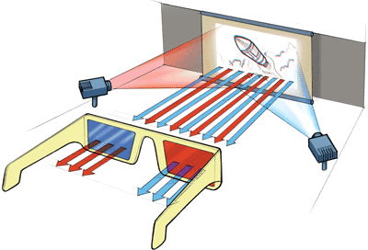
Working of Anaglyph Glasses
On the screen ,two images one blue and one red is displayed
The lenses only let one image into each eye

Slide 26
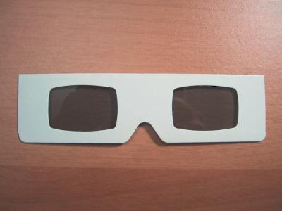
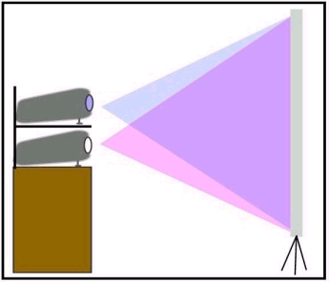
Working of polarized glasses
Polarized lenses are both a gray color and let color through
The lenses are specially cut at opposing 45 degrees
Two images are projected on the screen and each one has a different polarization

Slide 27
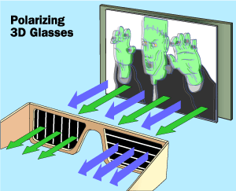
The polarized glasses allow only one of the images into each eye because each lens has a different polarization.

Slide 28
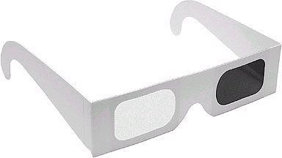
Working of pulfrich glasses
These glasses use the concept of one dark and one light lens to form 3D images
The image through the dark lens reaches the brain slightly after the image that went through the clear lens, creating a 3D illusion

Slide 29
CONCLUSION AND FUTURE SCOPE
3-D Password setting is a very useful technology for the areas where high security risk is involved
3-D tattoos and street art has capacity to capture the market of advertisement industry
3-D printing has a great future scope for example NASA engineers are printing 3-D printing parts, which are structurally stronger and more reliable than conventionally crafted parts, for its space launch system. Use in medicine: jaw transplant , to grow new human tissue with the help of bio printer

Slide 30

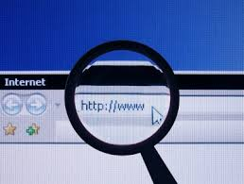
Bibliography
<http://www.stcroixstudios.com>
<http://www.3dcompany.com>
<http://www.3dgw.com>
<http://www.panorama.net>
<http://www.google.co.in>

Slide 31


Slide 32

QUERIES

