Slide 1
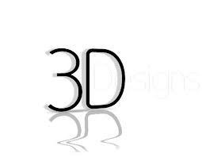
3D Technology
.

Slide 2
CONTENT
Introduction
History of 3D technology
Different types of technology
3D Camera
3D Scanners

Slide 3
INTRODUCTION
A 3d display is a screen that shows a three dimension Picture
It is a visual representation system that tries to create moving Objects in the third dimension

Slide 4
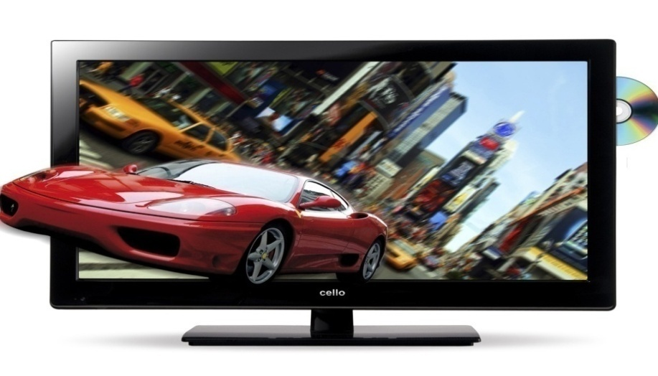

In simple that we have feel that whatever happens in 3D effect it is part of our real life.

Slide 5
History of 3d technology
In 1844 David Brewster introduces the stereoscope (3d camera)
In1855 the Kinematoscope invented (3d video camera)

Slide 6

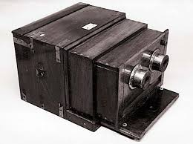
Stereoscope
(3D camera)
Kinematoscope
(3D video camera)

Slide 7
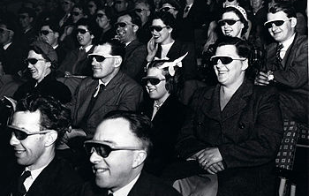
Audience wearing special glasses watch a 3D "stereoscopic film" at the Ambassador Hotel Theater in Los Angeles on 27 September 1922

Slide 8
HOW IT WORKS
To understand the basic 3D technology techniques, we must have an idea about the 3D glasses.
At present, there are around two main kinds of 3D glasses technologies which are called as active and passive.

Slide 9
Different Types of 3D Technology
anaglyph 3D technology
polarized 3D technology
active 3D technology
parallax-barrier 3D technology

Slide 10
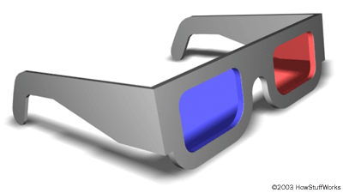
Anaglyph glasses
The purpose of
3D glasses is to
filter a separate
image into each
eye

Slide 11
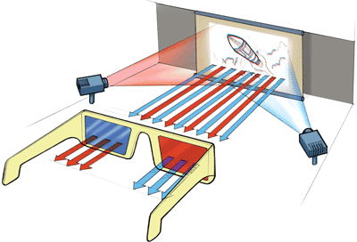
Anaglyph glasses
In this system, two images are displayed on the screen, one in red and the other in blue (or green). The filters on the glasses allow only one image to enter each eye, and our brain does the rest

Slide 12
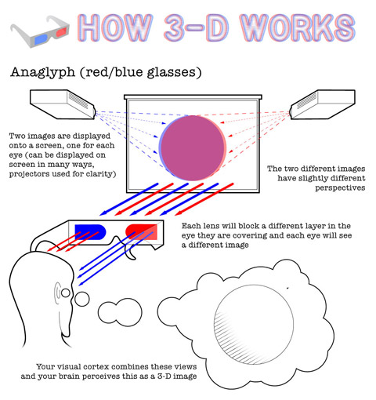
Anaglyph glasses

Slide 13
Active shutter 3D
The active shutter glasses required for the 3D technology is categorized into two main kinds which are called as…
liquid crystal shutter glasses
display glasses.

Slide 14
Active shutter 3D
Used at HOME THEATER.
Image Looks Great.
There is a battery in it.

Slide 15
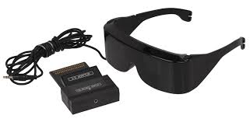
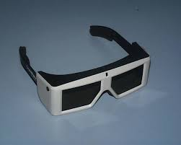
Active shutter 3D Glasses

Slide 16
Active shutter 3D
when the TV is showing an image for the left eye, the left eye's shutter will be open and the right eye's shutter will be closed.
A fraction of a second later the TV will refresh to show an for the right eye, and the right eye's shutter will open and the left eye's shutter will close.

Slide 17
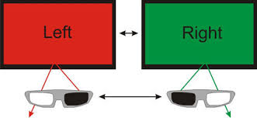
Active shutter 3D

Slide 18
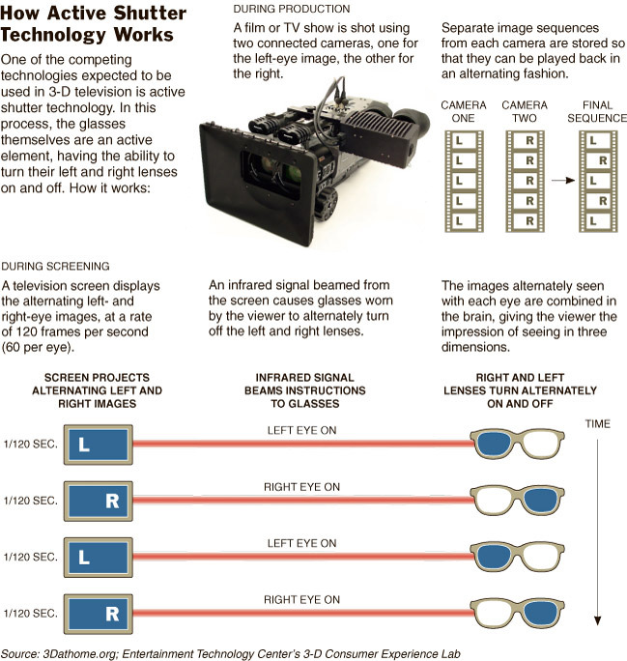
Active shutter 3D
ACTIVE SHUTTER CAPTURING
ACTIVE SHUTTER SCREENING

Slide 19
passive polarized 3d glasses
Two of the presently used are passive 3D glasses are..
linearly polarized glasses
circularly polarized glasses.

Slide 20
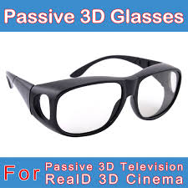
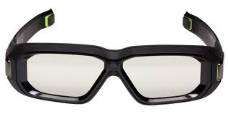
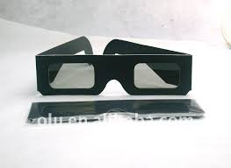
Images of passive 3D glasses

Slide 21
passive polarized 3d glasses
Two images intended for each eye are displayed from two separate projectors.
Each image is projected with a polarization mutually orthogonal to the other polarization.
Polarized 3d glasses are then used with polarized filters to ensure that each eye receives only the intended image.
It works well, and the required glasses are cheap and light.

Slide 22
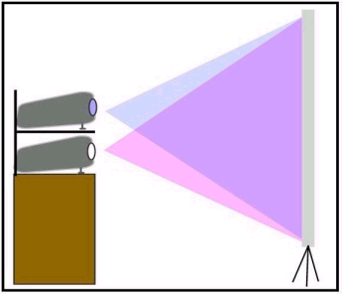
How Do Polarized 3D Glasses Work?
Two images are projected on the screen and each one has a different polarization

Slide 23
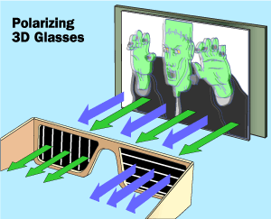
How Do Polarized 3D Glasses Work
The polarized glasses allow only one of the images into each eye because each lens has a different polarization.

Slide 24
PASSIVE 3D V/S ACTIVE 3D
PASSIVE 3D
ACTIVE 3D
ITS CHEAP..
PASSIVE 3D DOSE NOT REQURED CHARGING..
THESE GLASSES ARE LIGHT & EASY TO USE..
NO HARMFULL EFECTS…
ITS COSTY..
ACTIVE 3D NEEDS TO BE CHARGE BEFORE USE..
THEY ARE HEAVY IN COMPARISION OF PASSIVE 3D.
PEOPLE COMPLAIN ABOUT HEADACHE .

Slide 25
Autostereoscopy
Auto 3-D, more formally known as auto-stereoscopic imaging, is a display technology that enables a 3-D (three dimensional) effect without requiring the viewer to wear special glasses.

Slide 26
Autostereoscopy
autostereoscopic displays technology include…..
lenticular lens
parallax barrier
volumetric display
holographic
light field

Slide 27
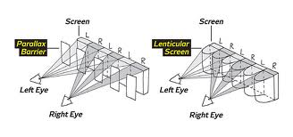
Parallax Barrier

Slide 28
Parallax Barrier
Parallax-barrier technology requires a barrier in front of a screen. The screen shows both the left and the right images, and the barrier effectively has slits in it that separate them out. If you look at the image from exactly the right spot, the slits will allow the left image through to your left eye, and the right image through to your right eye, with no overlap.

Slide 29
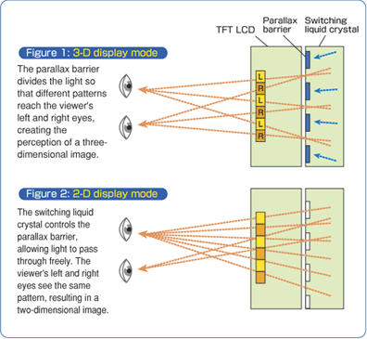
parallax barrier

Slide 30
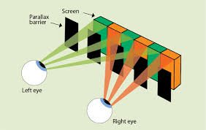
Parallax Barrier

Slide 31
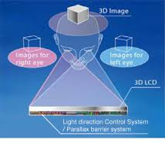
parallax barrier

Slide 32
3D Camera
A 3D digital camera is a camera that is capable of taking pictures in 3D.
3D cameras use two lenses so two images are captured with the right and left lens at the same time.

Slide 33
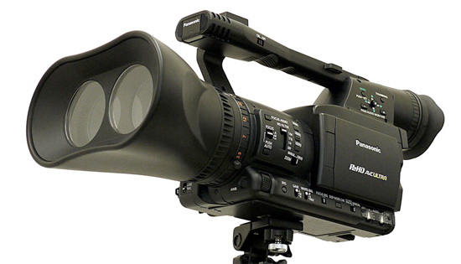
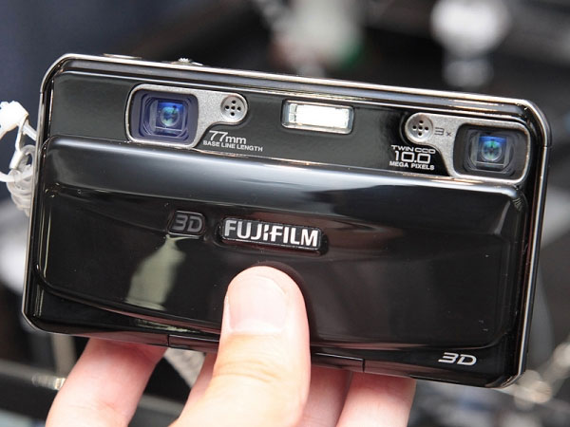
3D CAMERAS
(3d-camera) Range imaging is the name for a collection of techniques which are used to produce a 2D image showing the distance to points...
3D cameras use two different lenses to shoot video or any object which are at same camera

Slide 34
3D Camera
camera has two lenses and two CCDs imagers that capture a scene much like your regular digital camera does, except, just like you have two eyes, the camera captures two scenes – one through each of the two lens/ccd configurations. so, instead of seeing a single two- dimensional flat image like a regular camera, the 3d camera shows two images, from two different points of view, and when combined and viewed appropriately, displays a stunning depth only available from 3d content!

Slide 35
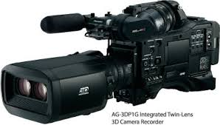
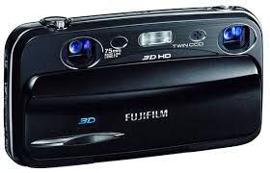
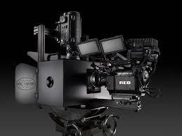
3D Camera

Slide 36
3D Scanner
A 3D scanner is a device that analyzes a real-world object or environment to collect data on its shape and possibly its appearance.

Slide 37
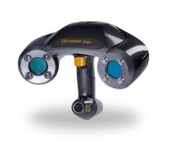
3D Scanner
3d scanning is a process which a physical object will be placed on the base of a 3d scanner and it will then be circled and scanned by lasers with surrounding pieces of a 3d scanner

Slide 38
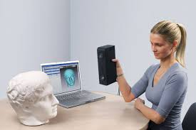
3D Scanner
The surrounding pieces of this scanner will encircle the model and the scanner will process what the object looks like and 3d file constructed around the physical object itself.

Slide 39
Different areas of 3D technology
3D Graphics
3D Modeling
3D Mobile phones
3d Internet
3D in Architecture
3D in Medical

Slide 40


