Slide 1
ECE 5233 Satellite Communications
Prepared by:
Dr. Ivica Kostanic
Lecture 16: Multiple Access Schemes
(Section 6.1 and 6.2 )
Spring 2014

Slide 2
Outline
Access schemes in satellite networks
FDMA implementation
FDMA properties
Examples
Important note: Slides present summary of the results. Detailed derivations are given in notes.

Slide 3
Satellite access
Two types of access
Access to transponders (FDMA and polarization)
Multiuser access to bandwidth of a transponder
Transponders
large bandwidth (36, 54 or 72MHz)
Shared between multiple users using FDMA, TDMA or CDMA access schemes
Two types of bandwidth assignment
Pre-assigned (fixed)
Assignment on demand

Slide 4
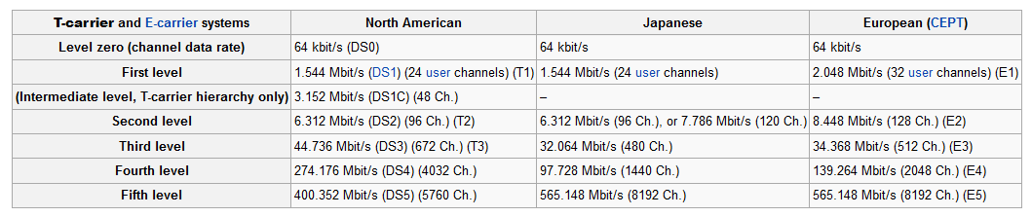
Multiplexing vs. Multiple Access
Multiplexing (Mux)
Common in all long distance communication
Aggregation of signals from multiple users
Performed on the ground (earth station)
Multiplexed signals are modulated on a single RF carrier
Most common: Time Division Multiplexing (TDM)
Inverse process: de-multiplexing
Multiple Access (MA)
Methodology for sharing same communication resource between multiple users
Implemented at the transponder
Satellite systems use combinations of Mux/MA
TDM-FDMA
TDM-SCPC-FDMA, etc.
Data rates for TDM Mux Standards

Slide 5
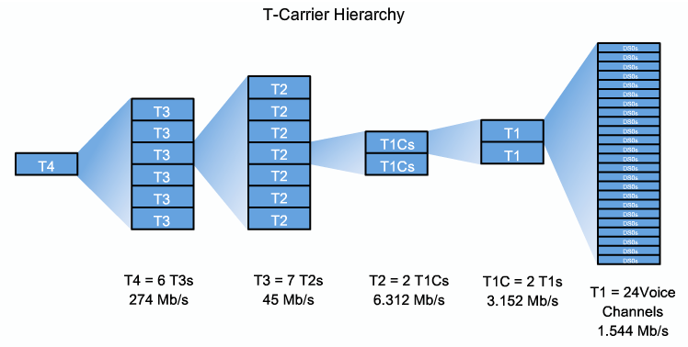
Example: T1-hierarchy
Multiplexing on T-1 may be
Channelized (respects the Mux structure)
Non channelized (uses proprietary Mux schemes within T-1 multiplex)

Slide 6
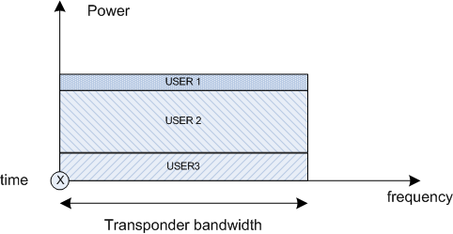
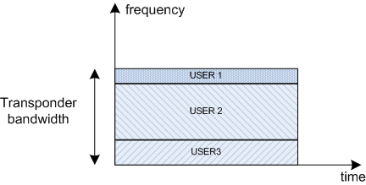
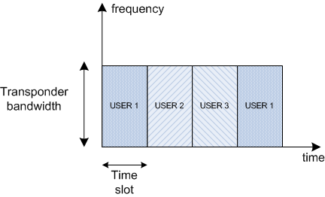
Fundamental principles of access schemes
Three principle transponder access schemes
Frequency Division Multiple Access (FDMA)
Time Division Multiple Access (TDMA)
Code Division Multiple Access (CDMA)
CDMA principle (separation in code domain)
TDMA principle
(separation in time domain)
Note: it is possible to have combination between different access schemes
FDMA principle
(separation in frequency domain)

Slide 7
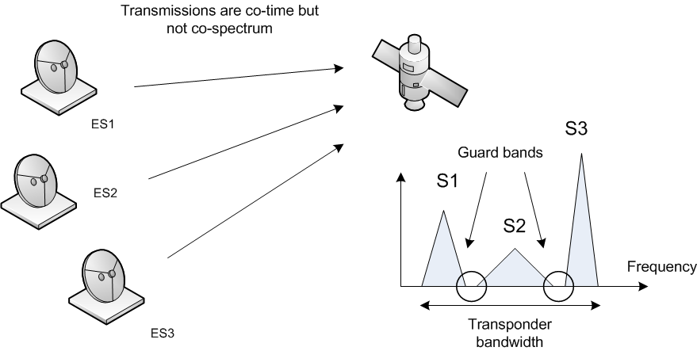
FDMA - implementation
Historically the first deployed scheme
Still dominant way of MA
Signals from earth stations may be either analog or digital
Access to transponder bandwidth may be either channelized or non channelized
Transmission from earth stations does not have to be synchronized
Frequency guard bands are necessary to prevent signal interference
Note 1: Earth stations may have portions of spectra that are different in size
Note 2: The received power from different stations may be different
Note 3. The received powers may change over time due to rain attenuation

Slide 8
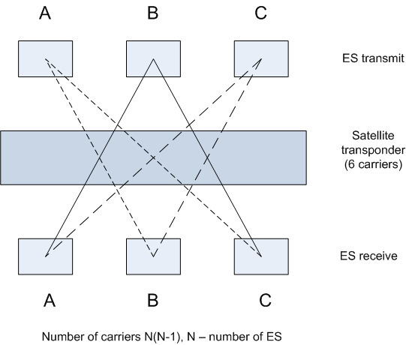
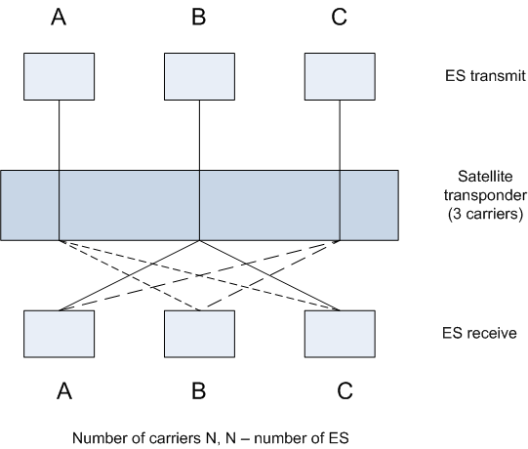
FDMA – two approaches
One carrier per link
Each ES demodulates only relevant traffic
Single connection per carrier (SCPC)
Each ES demodulates all traffic and keeps the relevant one
SCPC is more efficient (less guard bands, less traffic segmentation, …) – more common in today’s deployments
One carrier per link example
Single connection per carrier

Slide 9
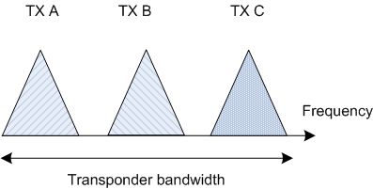
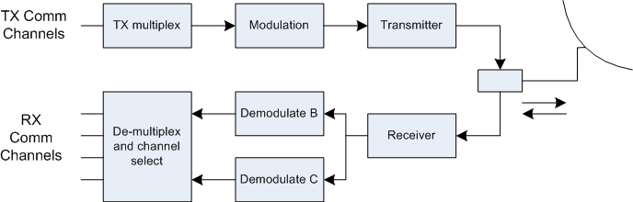
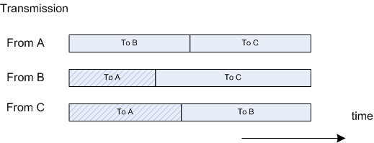
FDMA – SCPC example
A tree station FDMA access
Signals received at the satellite
Block diagram of Earth station A
Note 1: Only portion of demodulated channels are directed to A. Channels for C and B are still demodulated by the receiver, but are discarded.
Assembling the signals at the base band

Slide 10
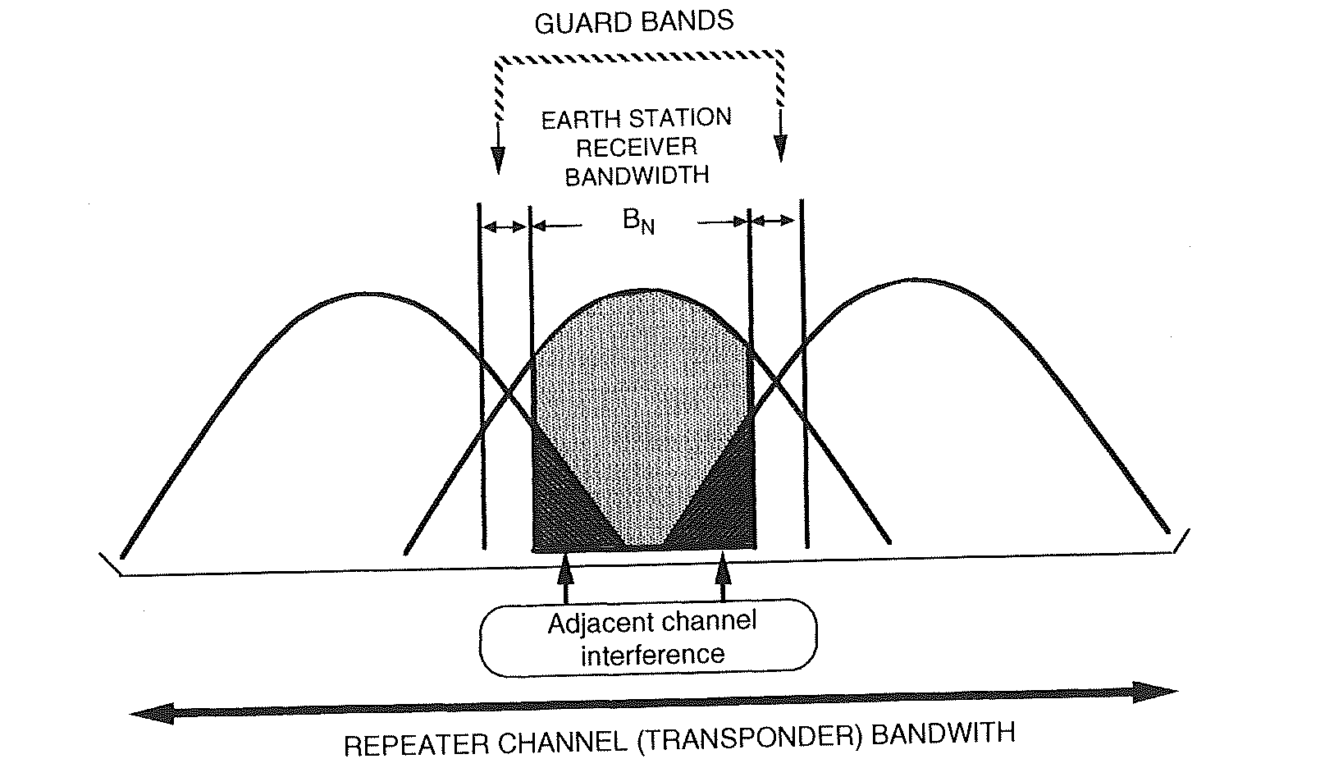
FDMA – Adjacent channel interference
Adjacent channel interference – limits on how tight are the signals sharing a transponder
To combat ACI – use guard bands
Function modulation scheme and pulse shape
Critical in cases when the signal experiences rain fade
Power spectral density of digitally modulated signal
Fourier transform of pulse shape
Fourier transform of symbol autocorrelation function

Slide 11
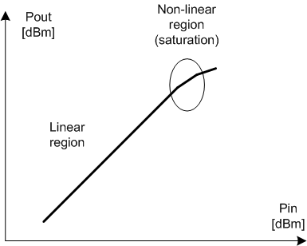
FDMA – IM products
Transponder amplifier is a non linear device
Nonlinearity causes intermediation products
Intermediation products of wideband signals are wideband – modeled as increase in noise floor
For a transponder – bandwidth much smaller than operating frequency
IM products of order 3 and 5 are important
Typical amplifier transfer function becomes nonlinear at high gains
Typically A>>b.
Note: Third order term grows 60dB/dec

Slide 12
IM example
Consider a case of 36MHz bandwidth transponder operating between 3705-3741MHz. The transponder caries two un-modulated carriers at 3718 and 3728MHz. Assuming that the PA characteristic may be modeled using cubic terms, determine the frequencies of “in-band” IM products.
A: f31 = 3708MHz
f32 = 3718MHz

