Slide 1
ECE 5233 Satellite Communications
Prepared by:
Dr. Ivica Kostanic
Lecture 19: Multiple Access Schemes (3)
(Section 6.3 and 6.4 )
Spring 2011

Slide 2
Outline
TDMA link capacity calculation
TDMA efficiency
Synchronization in TDMA networks
Transmit power in TDMA networks
Examples
Important note: Slides present summary of the results. Detailed derivations are given in notes.

Slide 3
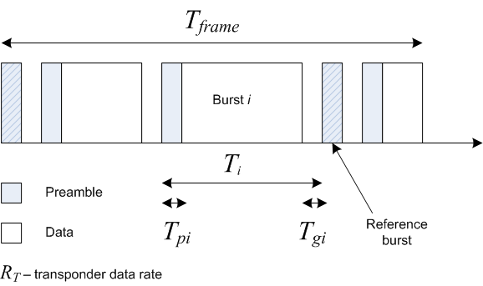
Capacity and efficiency of TDMA
Multiple earth station sharing transponder
TDMA efficiency
Time allocated for data transmission
Note 1: guard and preamble times are usually the same for all earth stations
Note 2: Rate of transponder depends on the bandwidth and modulation/coding scheme
Total available rate for user traffic
Rate for the ith user

Slide 4
Example
Consider a satellite with following parameters
Frame duration: 2ms
Preamble duration (reference station): 4.77 us
Preamble duration (other earth stations): 4.63 us
Guard time: 1.06 us
Two reference burst per frame and satellite rate of 120Mbps
Determine
Total user data rate (A: 115.82 Mbps)
Total user data rate if the satellite is shared by 10 equal earth stations (A: 11.58Mbps)
TDMA efficiency (96.52%)
Note: in satellite networks TDMA efficiency is above 90%

Slide 5
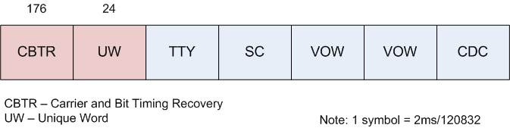
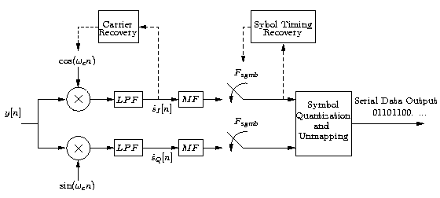
TDMA synchronization
Preamble example
Synchronization stages
Carrier recovery – required for coherent demodulation
Bit synchronization – required for matched filter operation
Burst synchronization – required for decoding of individual earth stations
Frame synchronization – required for proper operation of TDMA
Synchronization data is embedded in the burst preamble
CBTR (Carrier and Bit recovery) and
UW (Unique Word)
Block diagram of QPSK RX
Note: CBTR usually has two parts: un-modulated part – carrier recovery, modulated part for bit sync

Slide 6
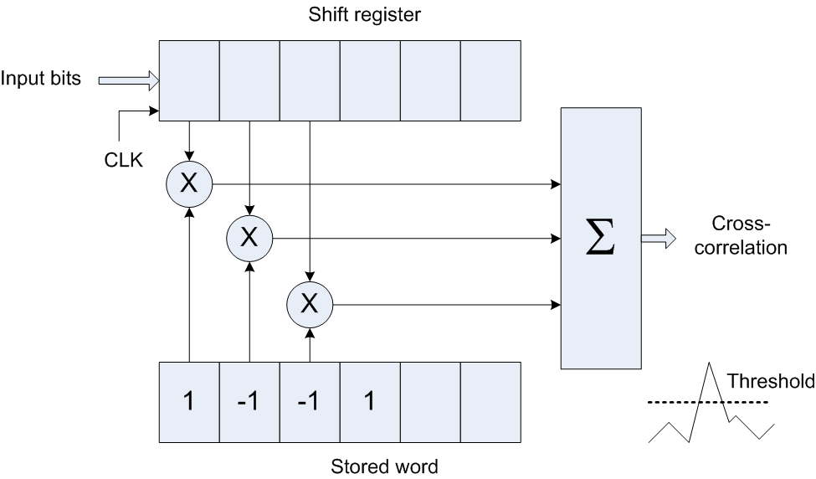
Unique word decoding
Unique word – modulated sequence of noise like autocorrelation properties
Two approaches
Station identified – different unique word
Station identified – unique word + signaling
Unique word determines the beginning of the frame at the receive side
It is important that unique word has
High probability of detection
Low probability of false alarm
If unique word is not detected – earth station misses the entire frame
Detection of UW sequence

Slide 7
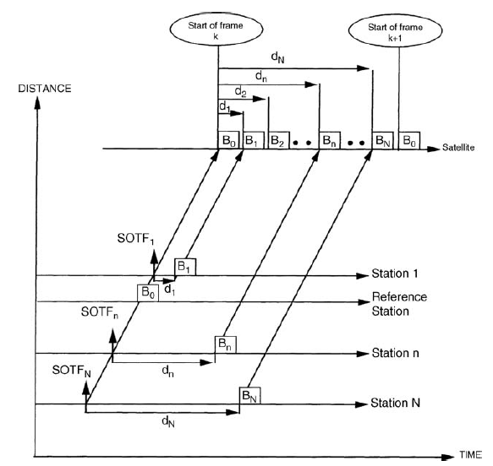
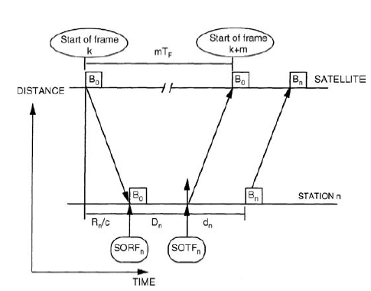
Synchronization between earth stations
All earth station burst need to arrive in proper times
For earth station n the burst needs to arrive at the offset d_{n} with respect to reference burst
The path traveled by each signal is different
Define
SOTFn (Start of Transmit Frame) – time when the earth station needs to transmit so that its burst is arriving at the time of reference burst
SORFn (Start of receive Frame) – time when the earth station receives reference burst
Example of burst time plan
(SOTF = start of TX frame)
Relationship between SOTF and SORF
Note: earth station needs to estimate D_{n}

Slide 8
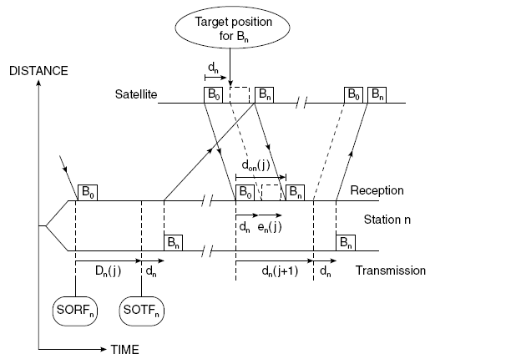
Determination of SORF-SOTF – closed loop
Step 1. Earth station sends a shortened burst at the best estimate of SOTFn
Step 2. The shortened burst is echoed by the satellite
Step 3. Earth station observes the error between desired and actual arrival of the burst
Step 4. SOTF is adjusted for the error
Note: shortened burst needs to contain only preamble
Time diagram for closed loop SOTF estimation

Slide 9
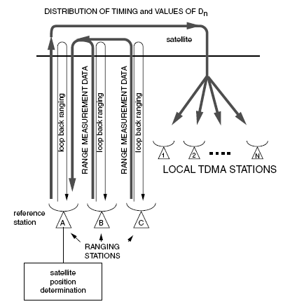
Determination of SORF-SOTF – closed loop
Three stations determine round trip time to the satellite (one is reference and two are auxiliary)
Based on three round trip times satellite is located
Times D_{n} are calculated and distributed to earth station using signaling
Note: open loop is used frequently in systems that have assignment on demand
Time diagram for open loop SOTF estimation

Slide 10
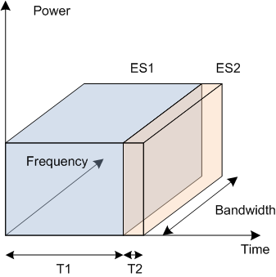
Transmit power in TDMA networks
Earth station access entire transponder bandwidth
Noise bandwidth is large
To maintain S/N ratio large signal power is required
Suitable for systems with large data throughput
Not suitable for small earth stations – high power difficult to achieve
Note: ES2 uses the same power even though the amount of data is much smaller

Slide 11
Examples
Example 6.3.2
Example 6.3.3

